Slide 1
TORQUE, STATICS AND ROTATIONAL DYNAMICS
NJ-OER TOPIC-9-10

Slide 2
Learning Outcomes
State the first condition of equilibrium. State the second condition of equilibrium. Calculate net torque from force, distance and angle Study the turning effect of force. Study the analogy between force and torque, mass and moment of inertia, and linear acceleration and angular acceleration. Calculate rotational kinetic energy. Demonstrate the law of conservation of energy. Calculate angular momentum. Demonstrate the law of conservation of angular momentum

Slide 3
Concepts
τ = Torque magnitude τ = Torque as a vector. It is negative for clockwise and positive for counterclockwise Torque is always defined in terms of a rotation with respect to a point. 𝝉net= Net torque. This is the vector sum of all torque F = magnitude of Force r="Distance of the force to the point of rotation" 𝜃=angle between the force and the line joining point of application to point of rotation | I = Moment of Inertia M= Mass R=Radius α = Angular acceleration ω = Angular velocity L = Angular momentum KEr= Rotational energy KET= Translational energy mi= mass of each object

Slide 4
Units
SI UNITS Torque is in “N.m” Angular velocity and angular speed is in “rad/s” Angular acceleration is in “rad/s²” Moment of inertia is in “kg m²” Energy or work is in Joule “J” Angular momentum is in “kg m²/ s”

Slide 5
Formulas and Constants
𝜏= 𝑟𝐹𝑠𝑖𝑛𝜃 𝜏= 𝑟⊥F 𝑟⊥=𝑟𝑠𝑖𝑛𝜃 perpendicular distance 𝜏= 𝑟F⊥ F⊥=F𝑠𝑖𝑛𝜃 perpendicular component For multiple forces τnet=Σ(+/-)τ Forces that rotates counterclockwise are - Forces that rotates clockwise are + 𝜏net= I 𝛼 acceleration 𝜏net = 0 (equilibrium) | I = Σ m 𝑅² 𝐿=𝐼𝜔 𝜏=𝛥𝐿/𝛥𝑡 ∑Li=∑Lf ∑Li=∑Lf if τ(external) = 0 𝑊=τnet 𝜃 KET=½ mv² KET=½ I 𝜔 ² 𝜔 =v/R for rolling E=KET+KEr+PE Ef=Ei if WNC=0

Slide 6
KEY STRATEGIES TO FIND NET TORQUE
There are 3 identical equations. Based on the problem, one of them might be more convenient 𝜏= 𝑟𝐹𝑠𝑖𝑛𝜃 𝜏= 𝑟⊥F 𝑟⊥=𝑟𝑠𝑖𝑛𝜃 perpendicular distance 𝜏= 𝑟F⊥ F⊥=F𝑠𝑖𝑛𝜃 perpendicular component These are magnitude equations Signs are determined by the direction of rotation
Draw the free body diagram
TORQUE DEPENDS ON THE POINT OF ROTATION
Identify the distances
Identify the angles
Identify the sign of Torque by asking which way would it rotate if it was the only force
Calculate individual torques and add

Slide 7
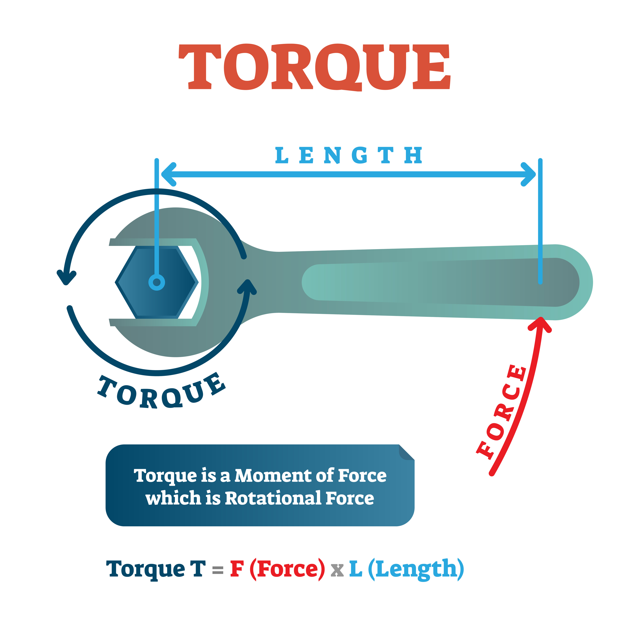
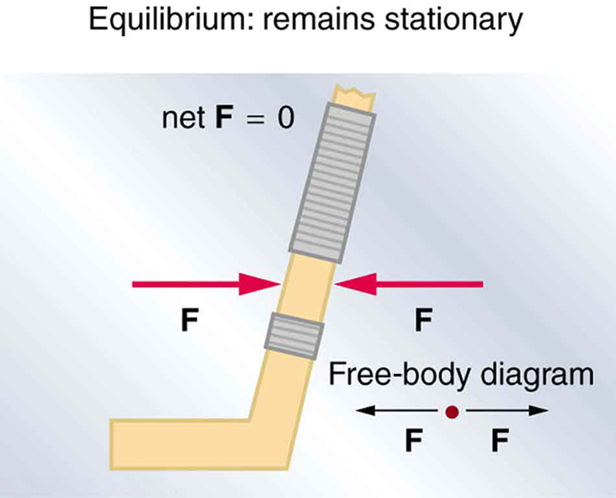
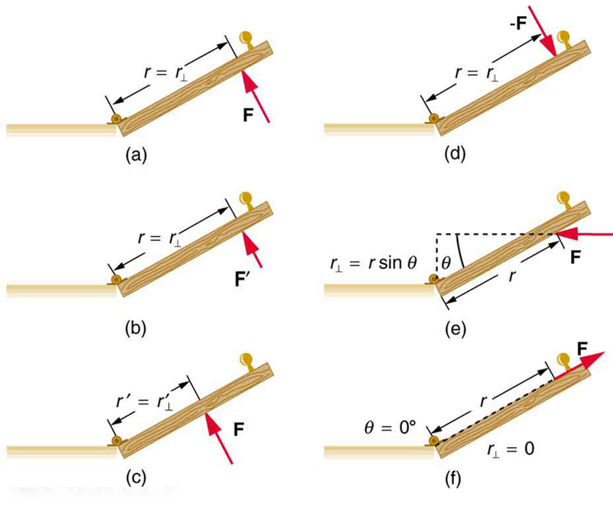
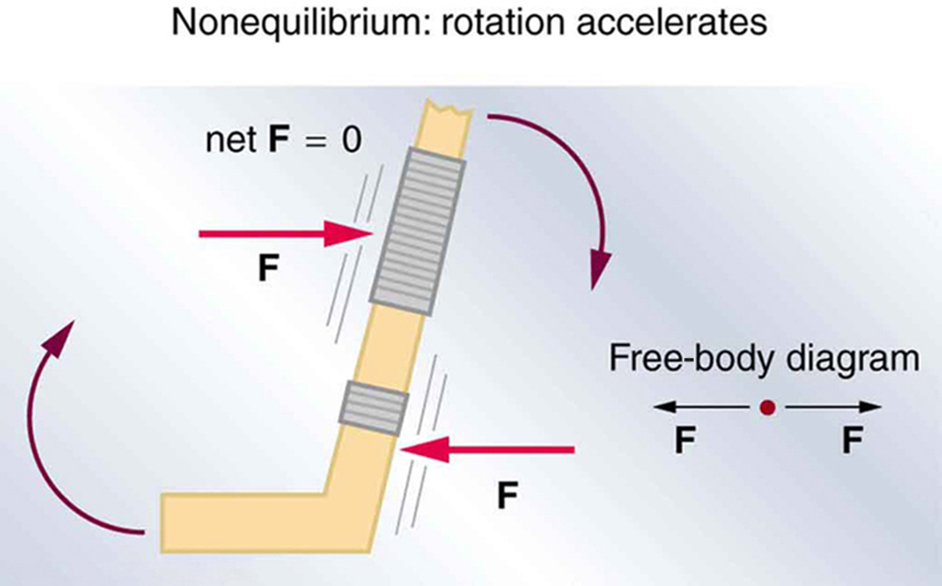
FINDING TORQUE USING FREE BODY DIAGRAMS
Torque is the rotational effect of force.
If a force can't rotate, its torque is zero.
Net torque is the vector sum of all torques

Slide 8
NET TORQUE CLASSWORK
A metal bar with 6 meters length is placed on the x-axis horizontally. Three forces are acting on it. F1=4N is applied upward 2 meters from the left edge, F2=6N is applied making 30 degrees with the x-axis from 4 meters distance from the left edge and F3=20N is applied towards right from the right edge.
Find τnet if a) There is a pin on the left edge b) There is a pin at the center c) There is a pin at the right edge.
F1
F2
F3
F1 | r1 | Torque1 | F2 | r2 | Torque2 | F3 | r3 | Torque3 | τnet
4 |  |  | 6 |  |  | 20
4 |  |  | 6 |  |  | 20
4 |  |  | 6 |  |  | 29
Rotate from the left
Rotate from the center
Rotate from the right
|𝜏|= 𝑟𝐹𝑠𝑖𝑛𝜃 however r changes for each case. r is the distance from the point of rotation to the point of application
Sign for individual torques Torque1 Torque2 Torque3 may also changedepending on the point of rotation.

Slide 9
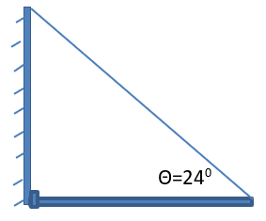
CLASSWORK ON TORQUE EQUILIBRIUM FIND THE MISSING FORCE
1) A uniform 1000-N piece of metal that is 12 m long is suspended horizontally by two vertical wires. One wire is at the left end and the other one is 9 meters away from the left end. What are the tensions
2) A uniform meter stick with 4 N weight is held in equilibrium by two supports. First string is at 20 cm mark and the other is at 60 cm mark. What are the normal forces on the supports?
4) A 2kg metal bar is attached to a wall, free to rotate about the pivot. Metal bar is 3 meters long. On the other end, the bar is attached to a cable that makes 24 degrees angle with the horizontal. Calculate the tension in the cable. Calculate x and y components of the reaction force that the pivot is exerting (Rx, Ry)
using the first condition of equilibrium.
𝜏= 𝑟𝐹𝑠𝑖𝑛𝜃 Fnet=0 𝜏net=0

Slide 10
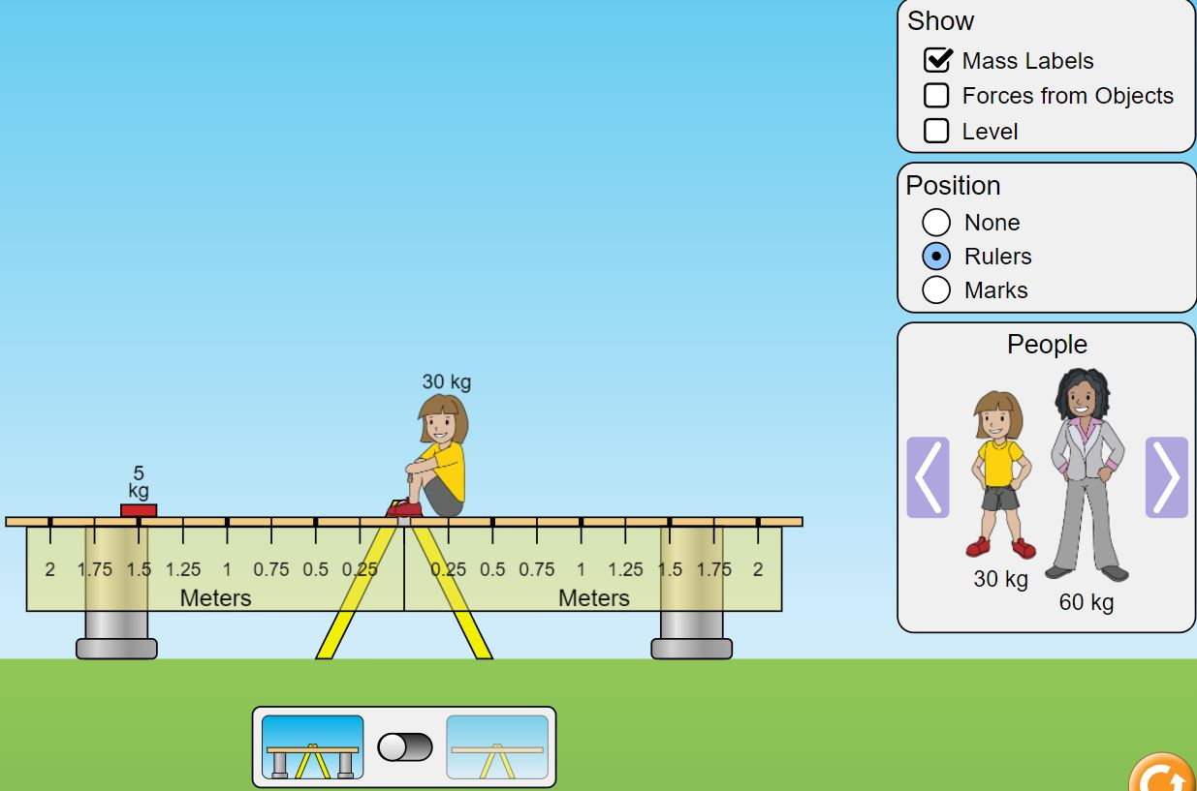
ACTIVITY ON EQUILIBRIUM: Simple Machines
Go to https://phet.colorado.edu/sims/html/balancing-act/latest/balancing-act_en.html Go to balancing LAB. Click on ruler. Place a M1=5 gr load at 1.5 meters distance.
Balance M1 load with a M2 load. Remove the supports. At equilibrium, mark the distance of F2 from the point of rotation. Write the value on the table below. Change M2 repeat for 3 more times Calculate each force using F = mg . g is gravity. Write the simple machine equation F1 X L1 = F2 X L2 Verify that Torque left is equal to Torque right. This is a magnitude equation. Find the reaction force R exerted by the support point using Newton’s Law for equilibrium.
M1 (gr) | F1 (N) | L1 (m) | M2 (gr) | F2(N) | L2 (m) | 𝜏(left)Nm | 𝜏(right) Nm | R(N)
5 |  | 1.5 | 5
5 |  | 1.5 | 10
5 |  | 1.5 | 15
5 |  | 1.5 | 30

Slide 11
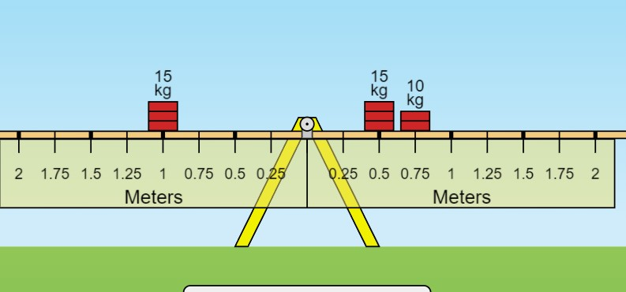
ADVANCED ACTIVITY ON NET TORQUE
Open https://phet.colorado.edu/sims/html/balancing-act/latest/balancing-act_en.html
Go to balancing lab, click on the ruler. Attach a M1=15 gr load 1 meter away from the point of rotation
Balance M1 load with two masses M2 and M3, mark their location from the point of rotation.
Write the value on the table below. Repeat for 3 more times using the values on the table.
Calculate each force using F = mg and calculate Torque for each force. Determine the signs for each torque
Add the Torques and verify that net torque is equal to zero at equilibrium.
m1(gr) | F1(N) | r1(m) | m2(gr) | F2(N) | r2(m) | m3(gr) | F3(gr) | r3(m) | 𝜏1(Nm) | 𝜏2(Nm) | 𝜏3(Nm) | 𝜏net(Nm)
10 |  | 1 | 5 |  |  | 5
10 |  | 1 | 5 |  |  | 10
10 |  | 1 | 5 |  |  | 15
10 |  | 1 | 5 |  |  | 20
τ = Fr since the weight is perpendicular, sin𝜃=1 τnet=Σ(+/-)τ
Forces that rotates counterclockwise are -
Forces that rotates clockwise are +

Slide 12
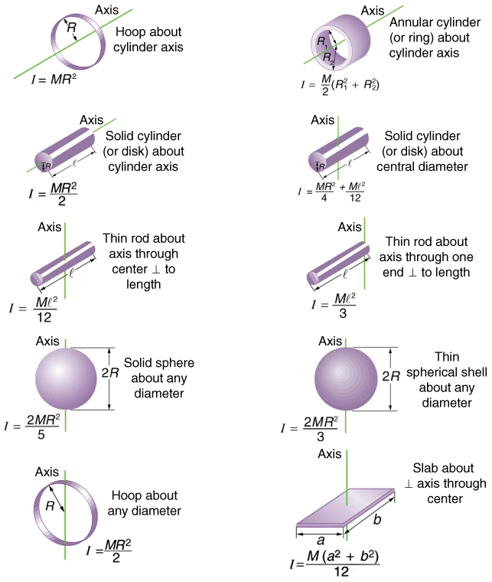
CLASSWORK ON MOMENT OF INERTIA
Moment of inertia is the mass equivalent for rotational systems
1) Calculate the moment of inertia of a 5 kg sphere with 0.4 meters radius
2) What should be the mass of a thin spherical shell of radius 0.2 meters so that its moment of inertia is 20 kgm².
3) A solid cylinder of mass 16kg and radius 0.5 m is rotated about the central diameter. What is the length of the cylinder so that its moment of is 2.4 kgm².
4) An annular cylinder with 4kg mass, 0.6 m outer radius and 0.4 meters inner radius is rotated about its center. What is its moment of inertia
5) A disc with I1=4kgm² is placed on top of a slab with I2=7kgm². What is the total moment of inertia.

Slide 13
ROTATIONAL EQUIVALANTS OF TRANSLATIONAL CONCEPTS AND EQUATIONS
 | inertia | motion | acceleration | momentum | kinetic energy | action
Translational | m | v | a | P=mv | KE= ½ mv² | Force
Rotational | I | ω | 𝛼 | L=Iω | KEr= ½ I ω² | Torque
 | Equilibrium Statics | Dynamics | Conservation of Momentum | Conservation Of Energy
Translational | Fnet=0 | F=ma | Σ Pi = Σ Pf | KEi+PEi=KEf+PEf
Rotational | 𝝉net=0 | 𝝉=I𝛼 | Σ Li = Σ Lf | KEi+KERi+PEi=KEf+KERf+PEf

Slide 14
CLASSWORK RELATED TO DYNAMIC SYSTEMS
1)A girl and a boy push a merry go round initially at rest. The boy applies 20 N force from 1.0 m away from the center tangentially and the girl applies 40 N from 0.9 m away from the center tangentially both rotating clockwise. Merry go round is a solid disc of radius 1.0 m and with mass m=80kg. Calculate (Find I and torquenet )
2) Two opposing forces acting on disc with 0.5m radius and I=4kgm². Disc is free to rotate about its center. First force is 30 N counterclockwise acting with 30 degrees angle relative to the radial direction and the other one is 20N clockwise acting with 45 degrees from the edge of the disc. Calculate its angular acceleration.
3) A 5.0 kg solid spherical ball with 0.2m radius is rolling without slipping with v=4.1 m/s. It climbs up a ramp. Calculate the maximum height it can reach before coming to stop. I=2/5 MR² 𝜔=V/R. Energy is conserved.
4) A solid disc of mass 2.0 kg and radius 0. 20 m rolls down from 2.5 meters height on an inclined plane. Its velocity at the end of the ramp is 5.3 m/s. How much energy is lost to friction? ( I= ½ M R² g= 9.80 m/s².)
5) A solid disc with moment of inertia I = 20 kg.m² is rotating with angular velocity ω = 6rad/s . A smaller disc at rest with I= 10 kg.m² is dropped on the larger disc. What is the final angular velocity of the system? (Li=Lf)
6) A skater has a moment of inertia of 5.0 kg m² when her arms are open, and at this time she is spinning at 0.90 rad/s. When she pulls in her arms in and her moment of inertia decreases to 4.5 kg ∙m², how fast will she be spinning?

Slide 15
REFERENCES
Slide 1: Adobe id= 51483838 even metal balance By pixeltrap
Slide 7 Middle image: Adobe id= 205136247 Torque physics example diagram, mechanical vector illustration poster. Rotational force mathematical equation.By VectorMine
Slide 7 Left and right images: Open Stax College Physics online textbook
Slide 9: Gen-Ed-Phys-I Workbook by M.Tabanli and J. Meenu
Slide 10-11 Screenshot from PhET Interactive Simulations University of Colorado Boulder
Slide 12: Open Stax College Physics online textbook

